Slide 1
Ka Tikaka o Ka Roro
www.nathanwallis.com
brains@nathanwallis.com
@nathanwallisxfactoreducation
@nathandwallis
The First 1000 Days
Understanding Your Brain

Slide 2
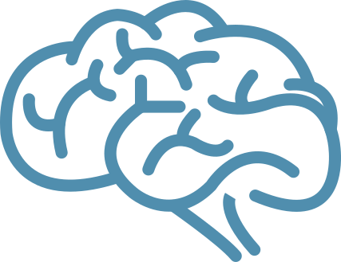
www.nathanwallis.com
The Decade of the Brain
The 1990's were called the decade of the brain due to significant advancements in brain scanning technologies.
The growth of the frontal cortex is experience dependent
The first thousand days are THE most important
Cozolino, Louis (2006). The neuroscience of human relationships: Attachment and the developing social brain. New york, NY,US: W. W. Norton & Co.

Slide 3
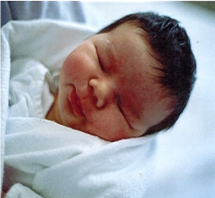
The Weight of a Brain
www.nathanwallis.com
Newborn baby brain
350 grams
Three year
old brain
1.2kg
Adult
Brain
1.4kg

Slide 4
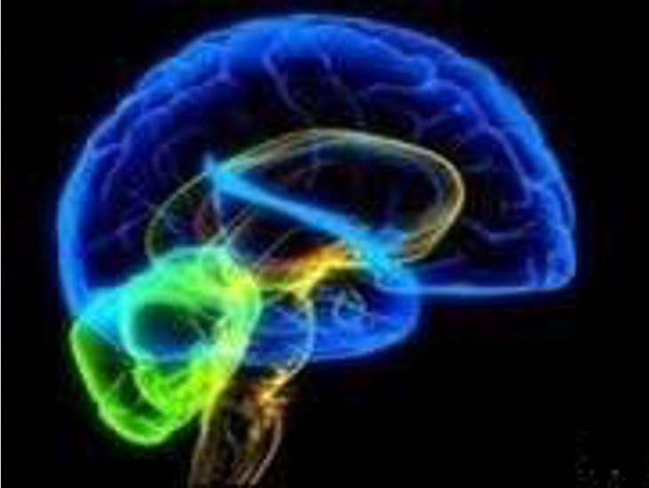
www.nathanwallis.com
The Human Brain

Slide 5
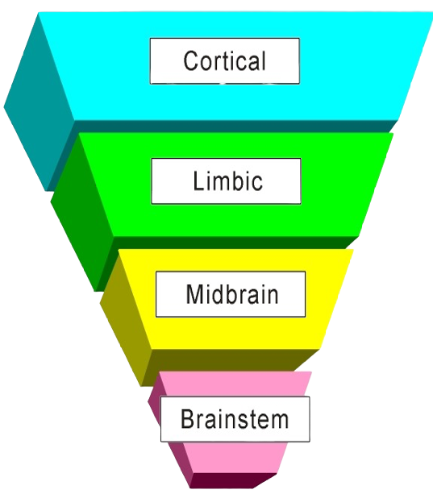
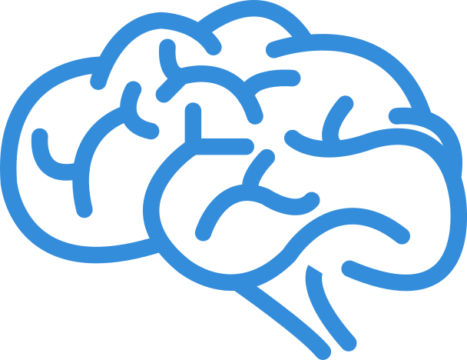
Perry's Neuro-Sequential Model
Empathy
Controlling yourself
Literacy
Emotional Response
Coordination
Movement
Survival
Heart Rate
Fight - Flight - Freeze
www.nathanwallis.com

Slide 6
As one increases, the other declines -
and vica versa.
High
Activity
Cortex
Brainstem
Low Activity
To be really using your cortex, your brainstem needs to be CALM

Slide 7
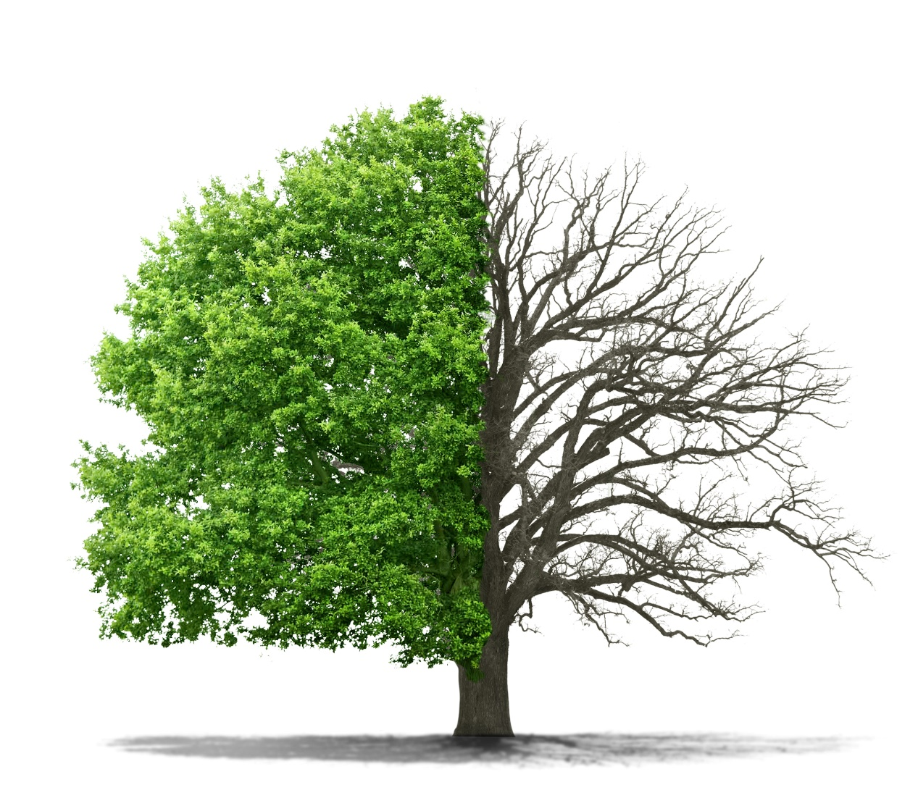
If we imagine the brain as a tree…
Endorphins =
Fertilizer
Cortisol =
Weed Killer

Slide 8
Consequence/Logic
Judgement/Empathy
Self-regulation/Cognitive Training
Inhibitory Control/Working Memory
Megacognition
Executive Functions
Validation/Self Esteem
Dispositions/Naming Emotions
Reframing/Mindfulness
Perseverence/Paralimbic system
Emotions
Rhythmic Patterning
Routine/Ritual
Motivation
Activity
Movement
Touch
Sensory Pathways
Predictability
Autonomy
Water and Kai
Safety
www.nathanwallis.com

