Slide 1
Roro
Change your Brain Change your Life
ka
o
Tikaka
Nathan Wallis
brains@nathanwallis.com @nathanwallisxfactoreducation www.nathanwallis.com
Ka

Slide 2
The Human Brain
www.nathanwallis.com

Slide 3
Perry's Neuro-Sequential Model
Empathy Controlling yourself Literacy
Emotional Response
Coordination Movement
Survival Heart Rate
Fight - Flight - Freeze
www.nathanwallis.com

Slide 4
As one increases, the other declines - and vica versa.
High
Activity
Cortex
Brainstem
Low
Activity
To be really using your cortex, your brainstem needs to be CALM
www.nathanwallis.com

Slide 5
www.nathanwallis.com
Effects of trauma, abuse and neglect on the developing brain.

Slide 6
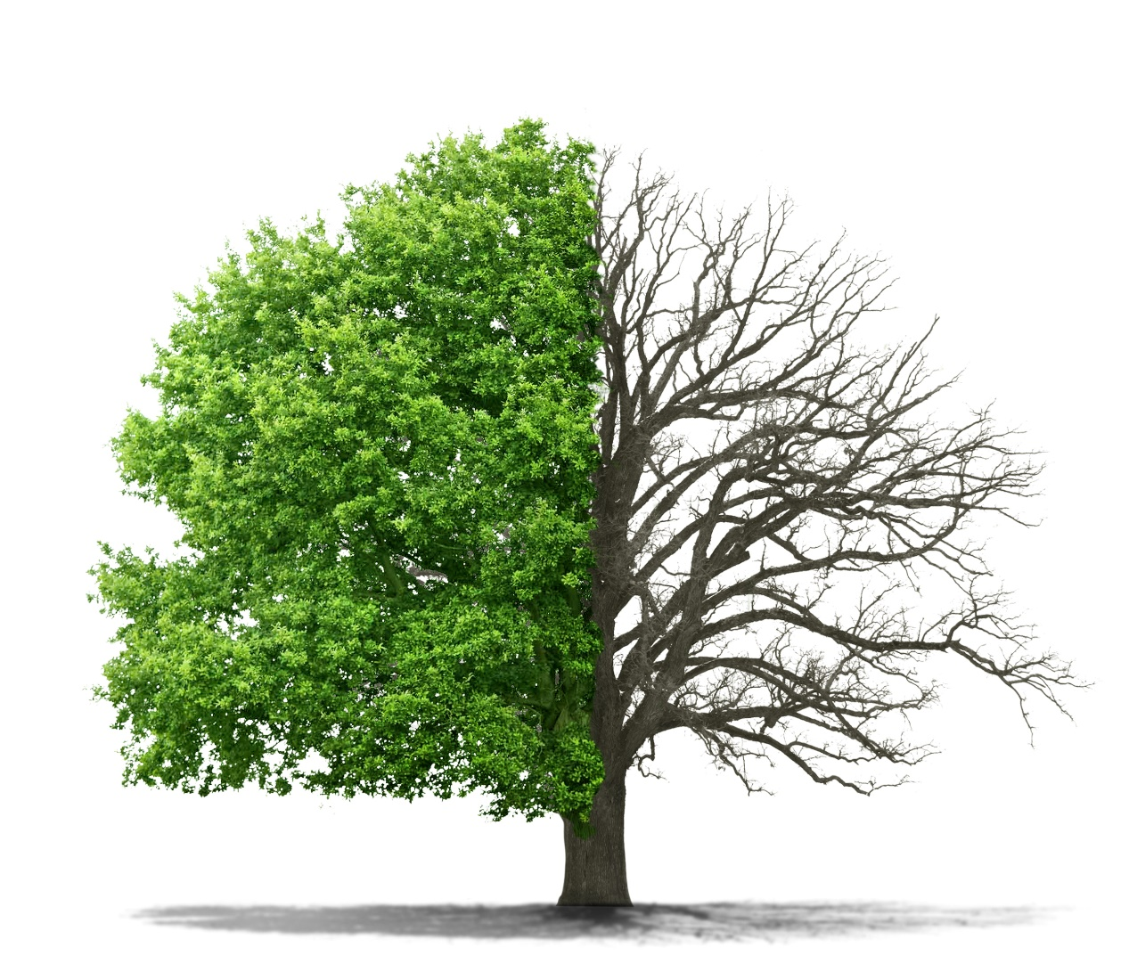
If we imagine the brain as a tree…
Endorphins =
Fertilizer
Cortisol =
Weed Killer

Slide 7
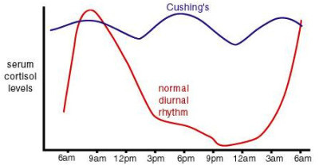
Typical & Atypcial
Cortisol Patterns

Slide 9
Consequence/Logic Judgement/Empathy
Self-regulation/Cognitive Training Inhibitory Control/Working Memory Megacognition
Executive Functions
Validation/Self Esteem Dispositions/Naming Emotions Reframing/Mindfulness Perseverence/Paralimbic system
Emotions
Rhythmic Patterning
Movement
Routine/Ritual
Motivation Activity
Touch
Safety
Sensory Pathways
Predictability Autonomy Water and Kai
www.nathanwallis.com

