Slide 1
TBS RAP Partnership Strategy
Working towards relationships that deliver genuine partnerships with First Nations Peoples communities - 17/11/2022
benevolent.org.au
Artwork by Jasmine Sarin
Notes:
To update this slide, click in the title and enter your text, do the same for the presentation title and the date.
To replace the image, click on the image, hit delete. You will see that you can now add an image by clicking on the photo icon. Click on the photo icon, select your image from your files and hit enter. Your new photo will be in place. Select “Arrange” from the file menu and choose ”send to back”.

Slide 2
Why do we need a Partnerships Strategy?
Leading cultural capability frameworks all emphasise that capability development is about far more than acquiring a defined set of knowledge – it is a continuous journey of cross-cultural learning that can only happen in deep and genuine relationship with Aboriginal and Torres Strait Islander peoples. – TBS Cultural Capability Framework 2022
benevolent.org.au
Artwork by Jasmine Sarin
Notes:
Mainstream organisations need to have an evidenced based Cultural Capability Framework to inform their approaches and ensure respect and accountability are central to relationships with First Nations.

Slide 3
Framing the Opportunity
We are guided by our Innovate Reconciliation Action Plan, a call to action for all our staff to work with First Nations Peoples communities to:
Find our place in sharing and supporting meaningful relationships that are instigated and led by First Nations Peoples.
With respect, demonstrate our commitment to reconciliation by partnering at a local and community level that supports the economic, political, and social inclusion of First Nations Peoples, their rights, needs and aspirations.
Seek partnership opportunities and commit resources to First Nations Peoples led innovation in the areas of research, high quality, effective, culturally safe services, and service design that and improves approaches to care.
Notes:
Reconciliation Action beyond tokenism needs to achieve real and meaningful outcomes for and with First Nations, evidenced by self determination deliverables..

Slide 4
Our Community Partnerships
We take a formal approach toward genuine partnership that is sustainable and measurable.
Our aspiration is for an organizational approach that develops deeper levels of trust and integrity.
We will investigate and support funding opportunities to strengthen the strategic development of partnerships and initiatives with First Nations Peoples, their leaders, communities’ organisations and peak bodies.
Design and implement co-design and co-production initiatives to ensure that the organisation engages in genuine partnership, keeping with protocol and expectations of community, leaders, and Elders.
Seek the development of innovative service models that are in alignment with protocol and expectations of community, leaders, and Elders.
Notes:
4th Objective rewording – Recruitment/Retention and workplace culture.

Slide 5
Opportunities.
Ensuring genuine partnerships in the pursuit of funding opportunities
The Benevolent Society is committed to ensuring that funding for First Nations Peoples services is awarded to First Nations Peoples organisations. When partnering with First Nations Peoples organisations on tenders, we will do so by providing:
Tender support only – we provide support to develop a tender and have no role in service delivery.
The Benevolent Society as subcontractor – we support the development of a successful tender and are engaged by the organisation for some elements of service delivery.
Transitionary / Joint partnership – we hold the contract for a period of time, working with the organisation to transition the contract to our partner, as desired by the organisation.
Notes:
To update this slide, enter your title where it says Bullet Points, replace title here with your subtitle. Enter your own text for the bullets as well as the quoted text to the right. It is best to make copies of this slide for reuse. You can also copy the bullets and / or the quoted text over to any other slide where required.

Slide 6
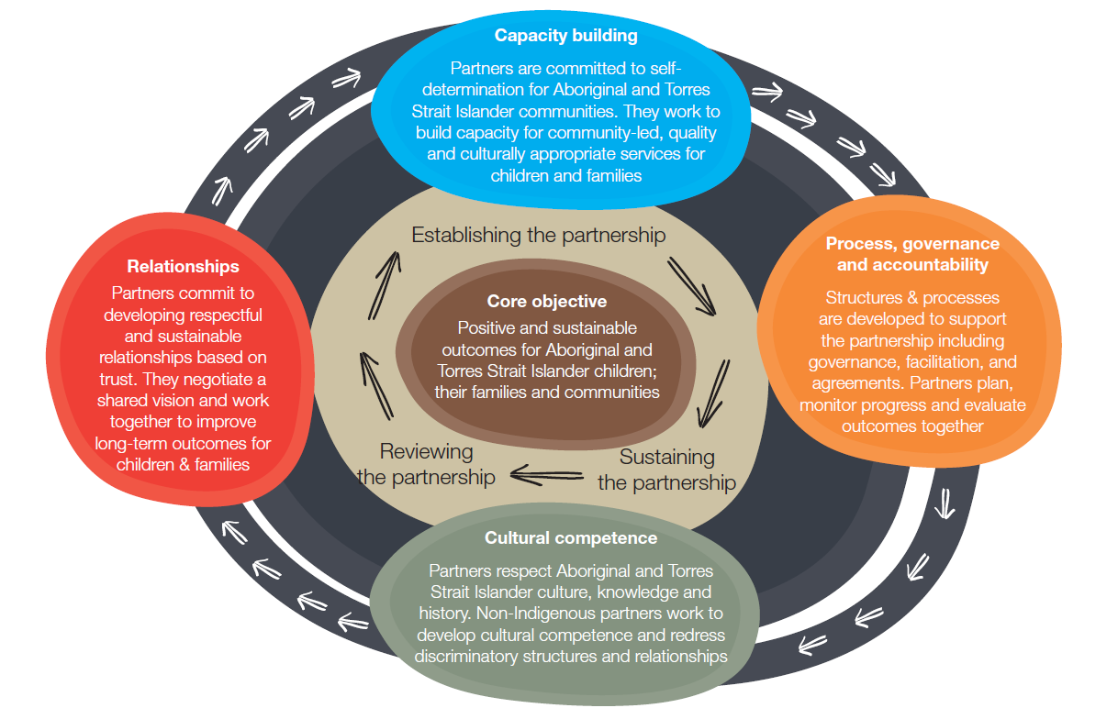
SNAICC Creating Change Through Genuine Partnerships

Slide 7
A model for authentic engagement with our Aboriginal and Torres Strait Islander partnerships
The Institute for Urban Indigenous Health and The Benevolent Society Early Childhood Approach Partnership.
The Background?
What is the Partnership?
How does it work?
What are the outcomes?
Overcoming the Barriers
Notes:
Reconciliation Action beyond tokenism needs to achieve real and meaningful outcomes for and with First Nations, evidenced by self determination deliverables..

Slide 8
TWO WAY BENEFIT
Partnering with community for service delivery in the Torres Strait Islands
The Mura Kosker & The Benevolent Society PARTNERSHIP
In January 2019, the Mura Buai Family Wellbeing Service began delivering services across the Torres Strait Islands. The establishment of Mura Buai was made possible through the policy reform of the Queensland Government, a partnership with The Benevolent Society and strong, committed leadership from Mura Kosker.
The Queensland Government’s ‘Our Way, A Generational Strategy’ for Aboriginal and
Torres Strait Islander Children 2017-2027, was modelled on the Family Matters Building Blocks and mapped a path for transformational change for Aboriginal and Torres Strait Islander children and their families and concrete action to build the community controlled sector, in a public and principled way.
Under ‘Our Way’, $16 million (2017-21) was committed for 33 Aboriginal and Torres Strait Islander wellbeing programs to be delivered by community controlled organisations,
in a co-design process between the Queensland Government and Queensland Aboriginal
and Torres Strait Islander Child Protection Peak (QATSICCP).
Notes:
The partnership between Mura Kosker and The Benevolent Society provides a model
for other organisations seeking to grow and support the capacity of the Aboriginal and
Torres Strait Islander community controlled sector. In 2019, the Mura Buai team has
9 full-time employees including caseworkers, intake and referral officers and managers
and includes three Benevolent Society service specialists. Mura Buai delivers services
to 14 islands within five clusters throughout the Torres Strait.

Slide 9
Key Actions and Innovations
What the Government did | What Mura Kosker did | What The Benevolent Society did
Adopted the four Building Blocks of the Family Matter’s Roadmap and legislated for self-determination. Held an industry briefing to better inform applicants of tender requirements. Recognised the authority and expertise of QATSICCP to design the wellbeing programs and tender. Undertook genuine co-design of the family wellbeing program with community controlled organisations. | Showed strong leadership in partnership negotiations to ensure Torres Strait self-determination. Led community consultations and managed community disputes. Delivered strong governance in the face of community pressure. Sought to grow the capacity of the organisation through a two way partnership and mutual benefit. | Completed the SNAICC partnership training and contracted a cultural broker to guide engagement. Negotiations were led by staff who were culturally capable and consistent in undertakings and decisions. Utilised cross agency government funding to enable engagement and the building of relationships. Made a financial commitment to service delivery in the Torres Strait islands.
benevolent.org.au
Artwork by Jasmine Sarin

Slide 10
Key Actions and Innovations
What the Government did | What the Government did
Adopted all 121 recommendations of the Carmody Special Inquiry into the Queensland Child Protection System. | Adopted the four Building Blocks of the Family Matter’s Roadmap as the basis for the new state wide Aboriginal and Torres Strait Islander strategy. | Was explicit in its legislation and policy reform that self determination, family led decision making and the Aboriginal and Torres Strait Islander Placement Principle would guide all decisions in service delivery for Aboriginal and Torres Strait Islander children and their families. | Recognised the expertise of QATSICCP to guide the development of the family wellbeing program so it was owned by Aboriginal and Torres Strait Islanders at both a system and family level.
benevolent.org.au
Artwork by Jasmine Sarin

Slide 11
Key Actions and Innovations
What the Government did | What the Government did
Adopted all 121 recommendations of the Carmody Special Inquiry into the Queensland Child Protection System. | Adopted the four Building Blocks of the Family Matter’s Roadmap as the basis for the new state wide Aboriginal and Torres Strait Islander strategy. | Was explicit in its legislation and policy reform that self determination, family led decision making and the Aboriginal and Torres Strait Islander Placement Principle would guide all decisions in service delivery for Aboriginal and Torres Strait Islander children and their families. | Recognised the expertise of QATSICCP to guide the development of the family wellbeing program so it was owned by Aboriginal and Torres Strait Islanders at both a system and family level.
Key Actions: Commitment to implement the recommendations from the Carmody Inquiry. Legislated for self determination Leadership from Government, Minister and Secretary to meaningful change Worked with SNAICC on design of ‘Our Way’
benevolent.org.au
Artwork by Jasmine Sarin

Slide 12
Key Actions and Innovations
What The Benevolent Society did | What the Government did
Committed to the principles of self determination for First Nations people as the key to effective service delivery and partnership. | Completed the SNAICC partnership training which provided guidance on best practice for partnership’s with First Nation community controlled organisations. | Contracted an expert cultural broker to guide The Benevolent Society’s approach to partnership, introductions to community organisations and provide expert advice on working with Aboriginal and Torres Strait Islander communities. | Gained support from the Queensland Department of Education to allow flexible use of early years development funding to support consultation in the Torres Strait.
Key Actions: Completed the SNAICC partnership training Engaged the cultural broker Engagement and negotiations were led by staff who were culturally capable and consistent in undertakings and negotiations Utilised cross agency funding to enable engagement and the building of relationships
benevolent.org.au
Artwork by Jasmine Sarin

Slide 13
Key Actions and Innovations
What Mura Kosker did | What the Government did
Developed and articulated a vision for growth and development for community controlled services on the islands that was supported by the community. | Identified the need for specialist skills to deliver the services and sought a partnership agreement to deliver those aspects of the service. | Led the development of the partnership through early engagement and ongoing negotiations with The Benevolent Society and the Government . | Led the consultation with community to explain the new service and the partnership arrangements.
Key Actions: Showed strong leadership. in partnership negotiations to ensure Torres Strait self determination. Led community consultations and managed community disputes. Delivered transparent governance, in the face of community pressure. Sought to grow capacity of the organisation through a two way partner.
benevolent.org.au
Artwork by Jasmine Sarin
Notes:
Partnership was founded from the beginning and committed to a time limited partnership with the recognised goal of a stand-alone community-controlled service in the Torres Strait.
Established accountable and transparent governance arrangements for the service and the partnership that could be explained and accepted by both the community and the funder.

Slide 14
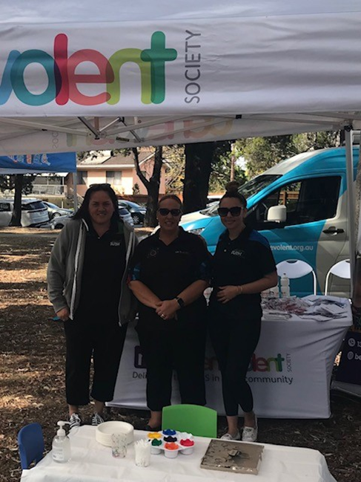
IUIH/TBS Partnerships Digital Story
https://www.dropbox.com/s/v0bhbr1mmlmosod/NDIS%20PARTNERSHIP%20v2.mp4?dl=0
Notes:
4th Objective rewording – Recruitment/Retention and workplace culture.

Slide 15
Thank you
Notes:
To edit this slide, change / add to the Thank you if desired or required. Update the large body text.

