Slide 1
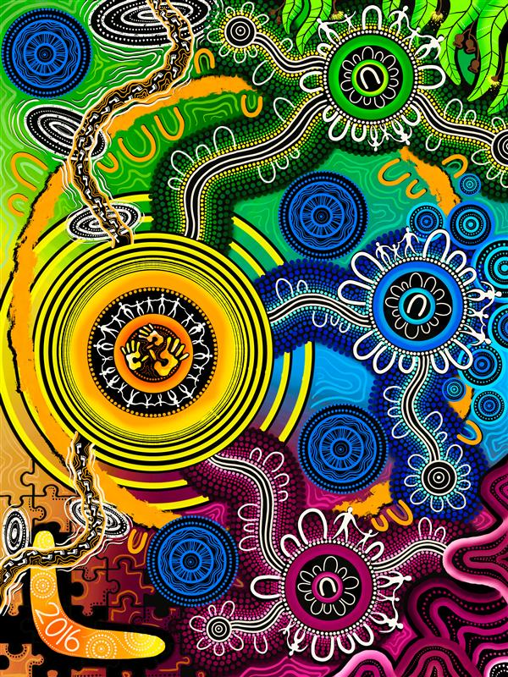
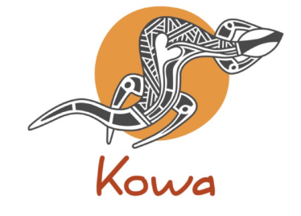
UMEL IN ACTION Ellise Barkley
Artwork used in the presentation is by Oumoula McKenzie

Slide 2
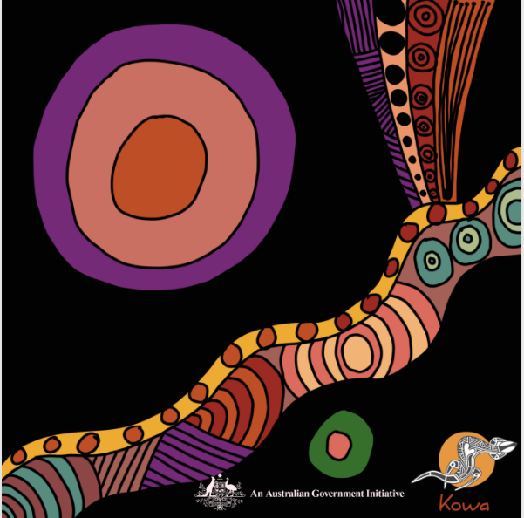
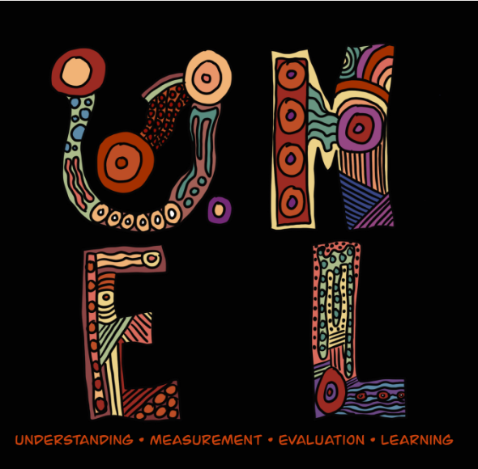

Slide 3
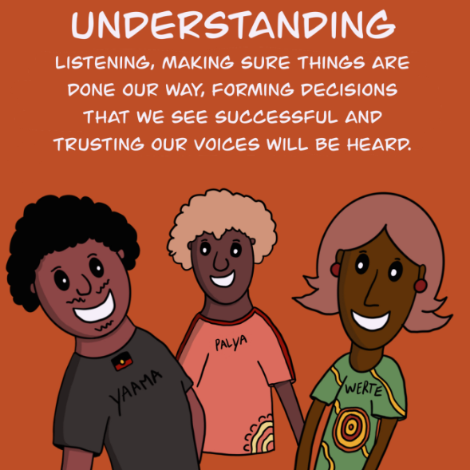
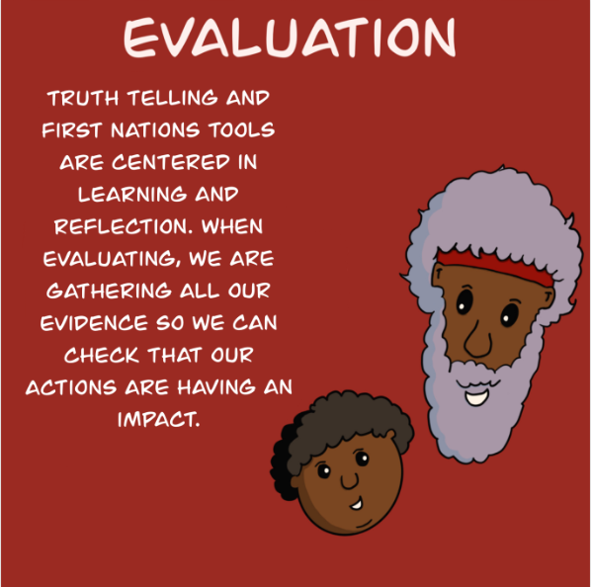

Slide 4
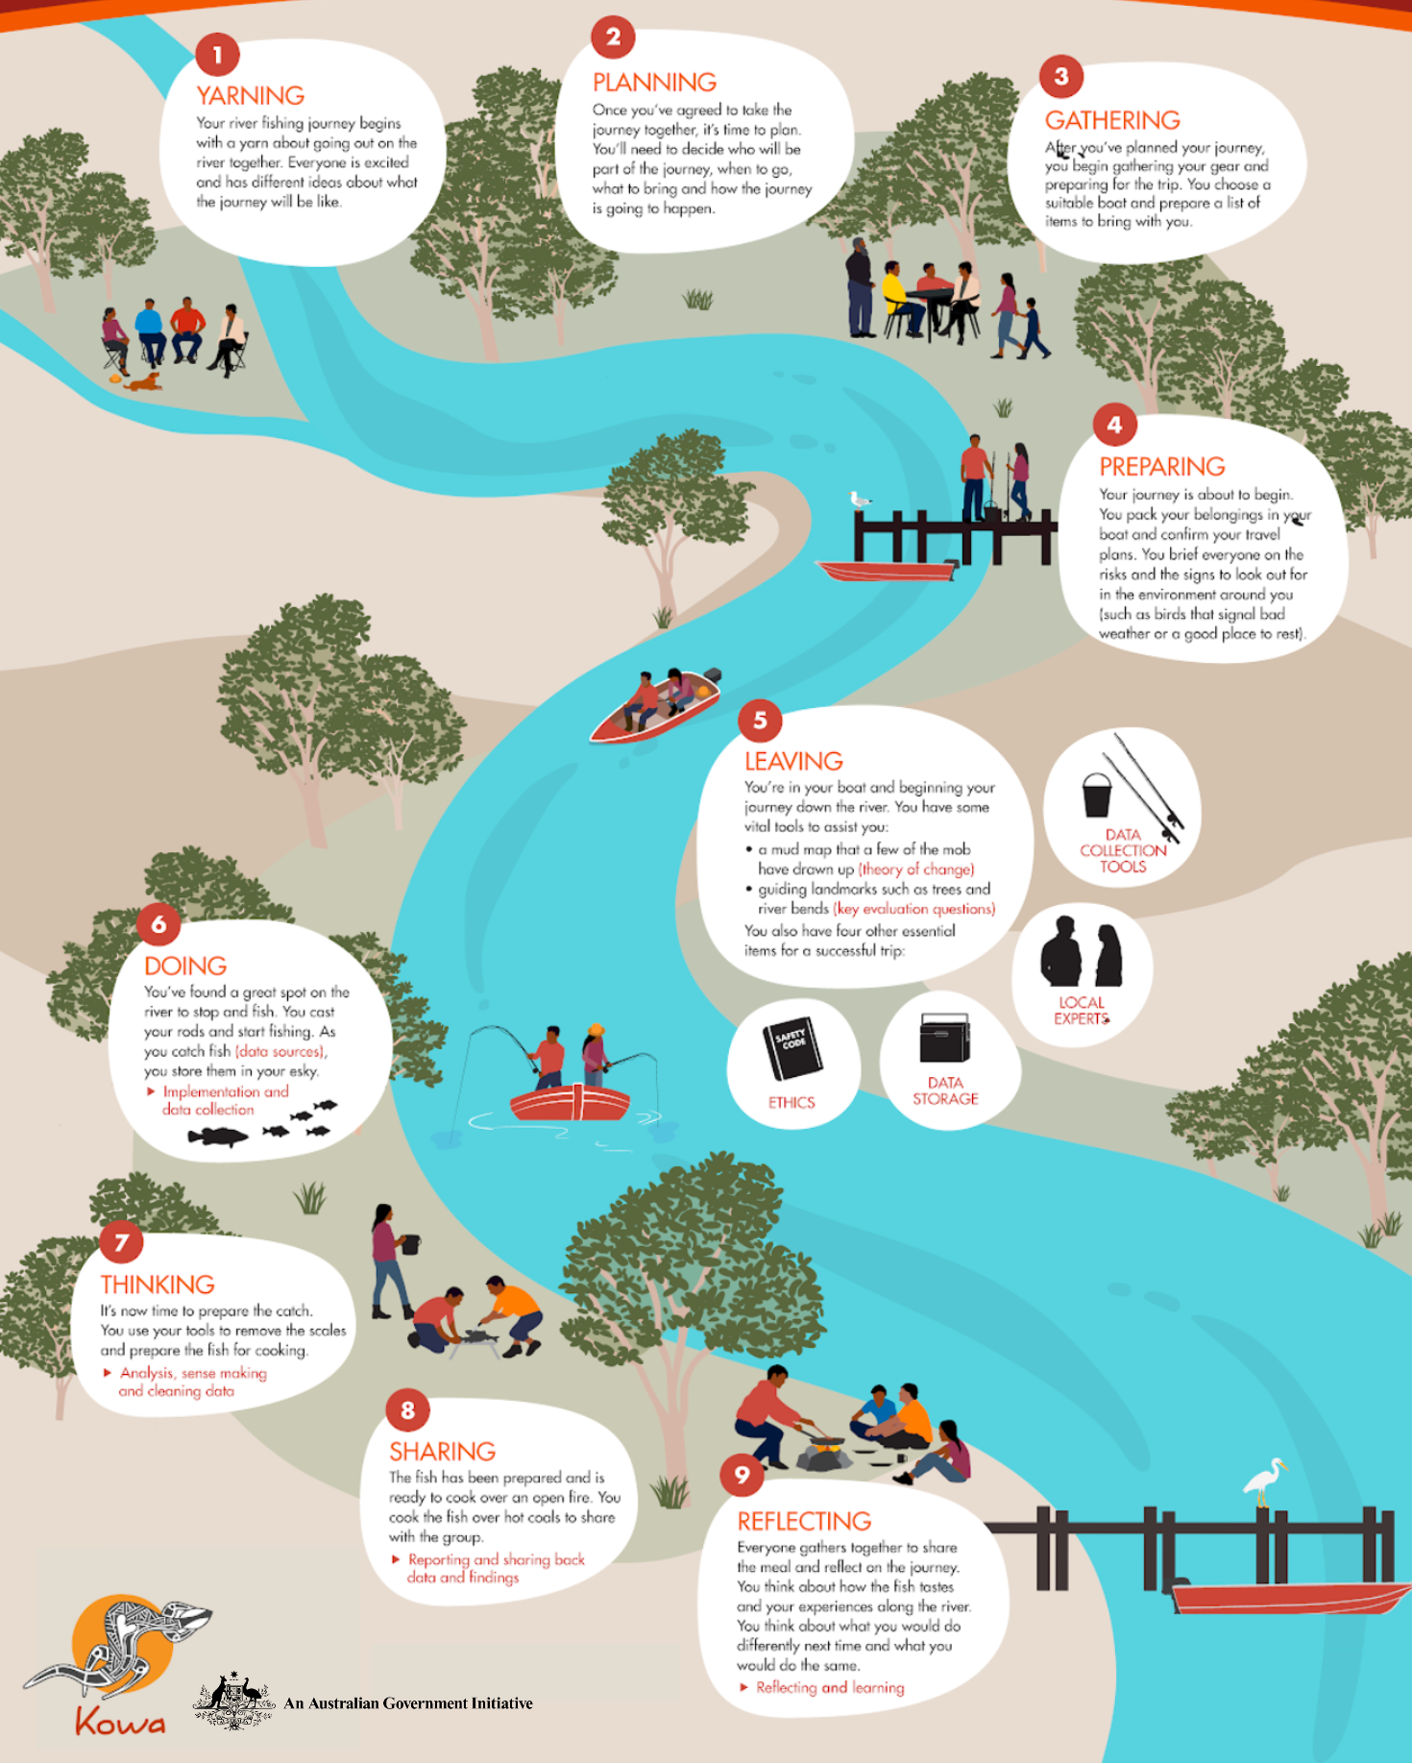
THE
LEARNING
JOURNEY
YARNING
PLANNING
GATHERING
PREPARING
LEAVING
DOING
THINKING
SHARING
REFLECTING

Slide 5
TOOLS
FOR THE JOURNEY
THEORY OF CHANGE
MEASURES/ INDICATORS
KEY EVALUATION QUESTIONS (KEQs)
MIX OF TOOLS FOR DATA COLLECTION INDIGENOUS DATA SOVEREIGNTY
WEAVING DATA & STORIES
IMPACT STORIES
SHARED REFLECTION & LEARNING
STEPPINGSTONES TOOL

Slide 6
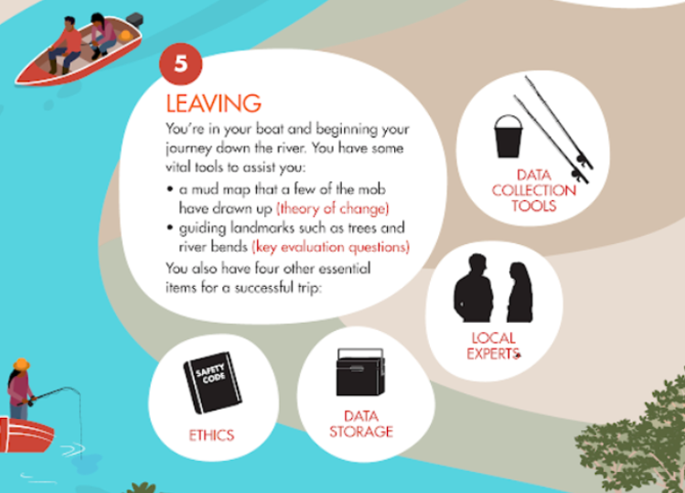
Working together
Better services and community experiences
Children and families >>

Slide 7
Theory of change is a mud map of the journey for change – how we think change will happen
Key evaluation questions are guiding landmarks that help reflect on the journey and our impact

Slide 8
THEORY OF CHANGE
By working together…

Slide 9
By working together…
We link up services and community has positive experiences…

Slide 10
By working together…
We link up services and community has positive experiences…
Children are healthy, have a strong connection to culture, and are learning

Slide 11
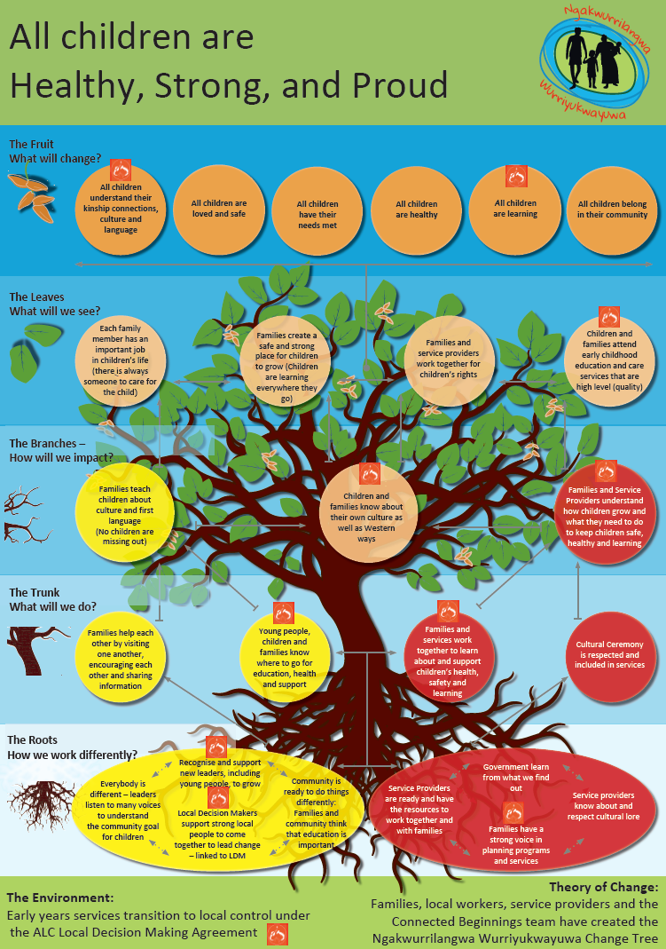
EXAMPLE: THEORY OF CHANGE

Slide 12
EXAMPLES: KEY EVALUATION QUESTIONS

Slide 13
EXAMPLES: KEY EVALUATION QUESTIONS
By working together…
WAYS OF WORKING & WORKING TOGETHER
To what extent is consultation happening with grass-root peoples (and all Language groups)?
How do we tap into the expertise in our community to make the changes we want?
How well are we upholding our principles and working together?

Slide 14
EXAMPLES: KEY EVALUATION QUESTIONS
We link up services and community has positive experiences…
CHANGES IN HOW WE THINK AND ACT
How do we get better community engagement to services?
What is community experience of services?
Are CB staff and partners having a positive experience?
How do we know government agencies are listening to us and acting on what we need?

Slide 15
EXAMPLES: KEY EVALUATION QUESTIONS
CHANGE & IMPACT FOR KIDS & FAMILIES
In what ways are we making a difference for kids and families?
Have meaningful gains been made in community?
Children are healthy, have a strong connection to culture, and are learning

Slide 16
TIP:
AGREE ON A SMALL
SET OF QUESTIONS
FIRST
THEN…
CHOOSE THE METHODS & TOOLS FOR COLLECTING DATA & STORIES

Slide 17
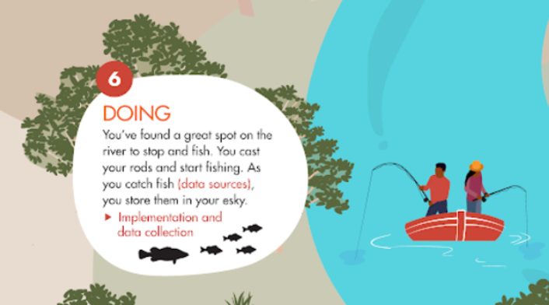
Working together
Better services and community experiences
Children and families >>

Slide 18
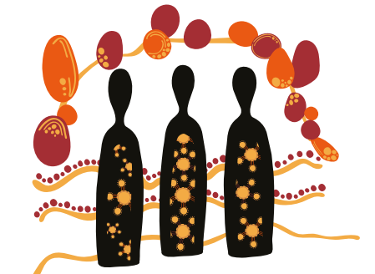
EXAMPLES OF TOOLS FOR GATHERING DATA & STORIES: - CHATS - IMPACT YARNS - CREATIVE METHODS - INDICATORS/METRICS
The artwork, titled The Flow of Impact, is by Quinton Vea Vea in collaboration with Tylah Mundine and Blak Impact
Link to impact yarns tool: https://www.kowacollaboration.com/resources
Example of HUM video story of impact ‘Working Together’ https://www.youtube.com/watch?app=desktop&v=1_iaIVALd80 :

Slide 19
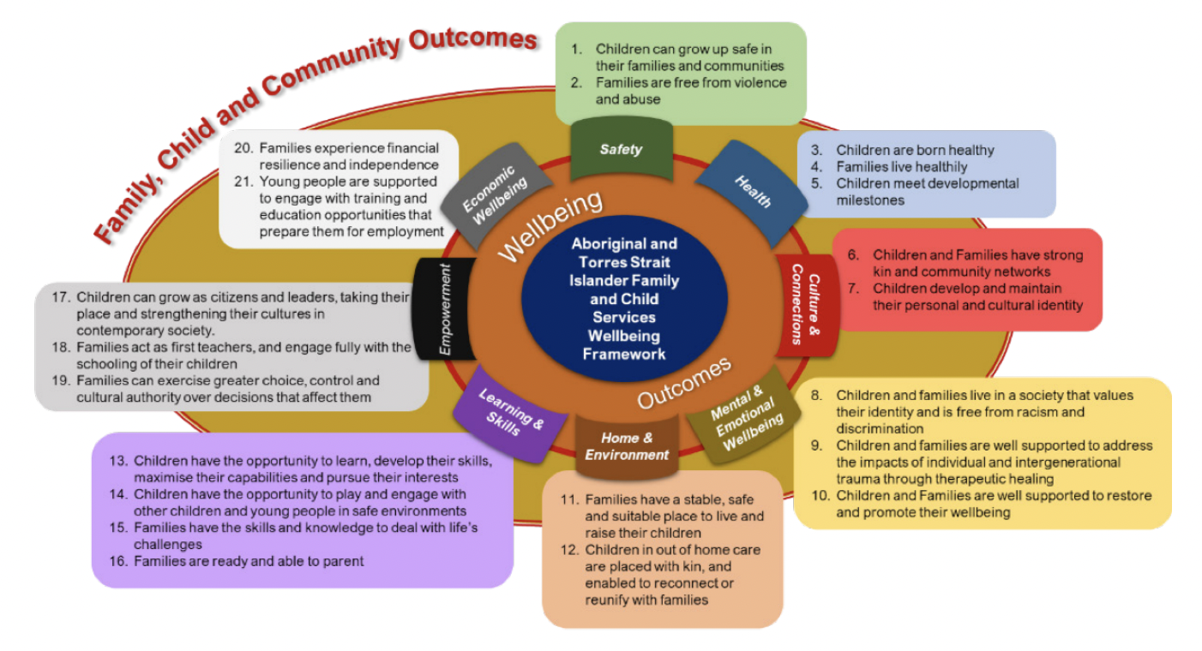
The First Nations Child and Family Services Wellbeing Framework
See UMEL Strategy for sites or https://www.snaicc.org.au/

Slide 20
PROTECTING DATA, INFORMATION, AND CULTURAL KNOWLEDGE

Slide 21
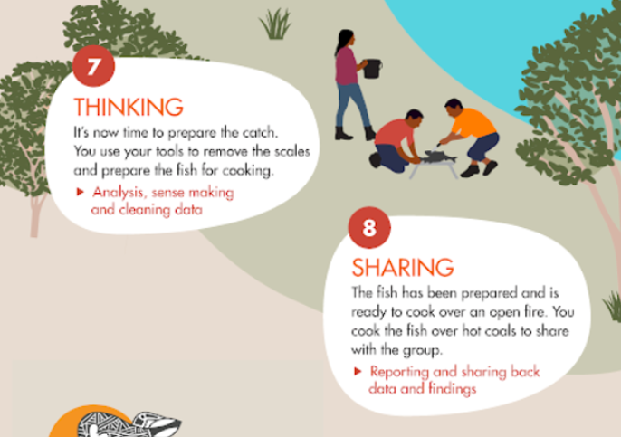
Working together
Better services and community experiences
Children and families >>

Slide 22
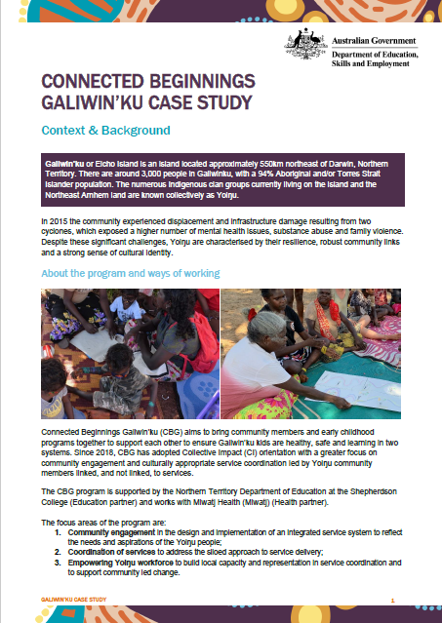
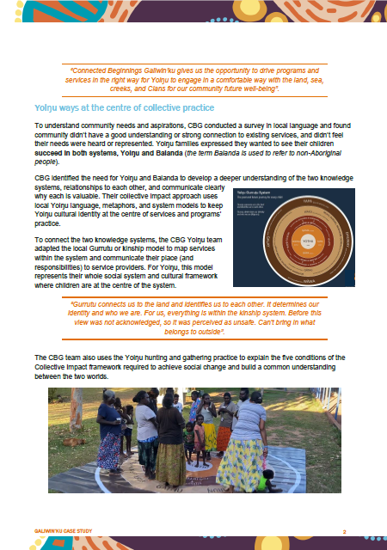
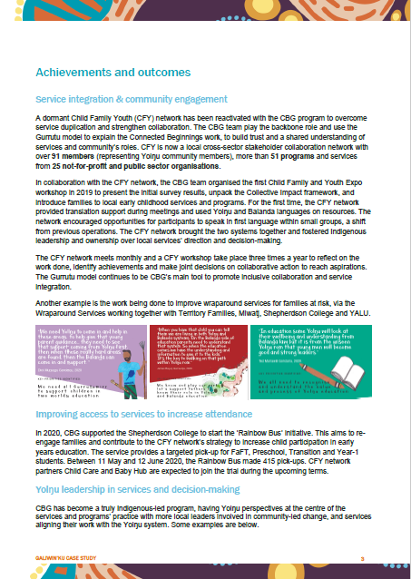
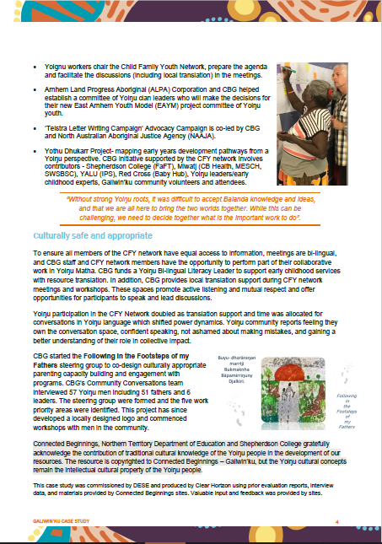
Working together
Better services and community experiences
Children and families >>

Slide 23
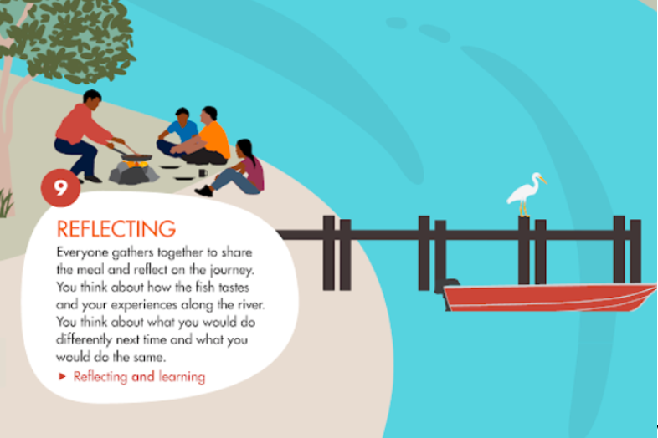
Working together
Better services and community experiences
Children and families >>

Slide 24
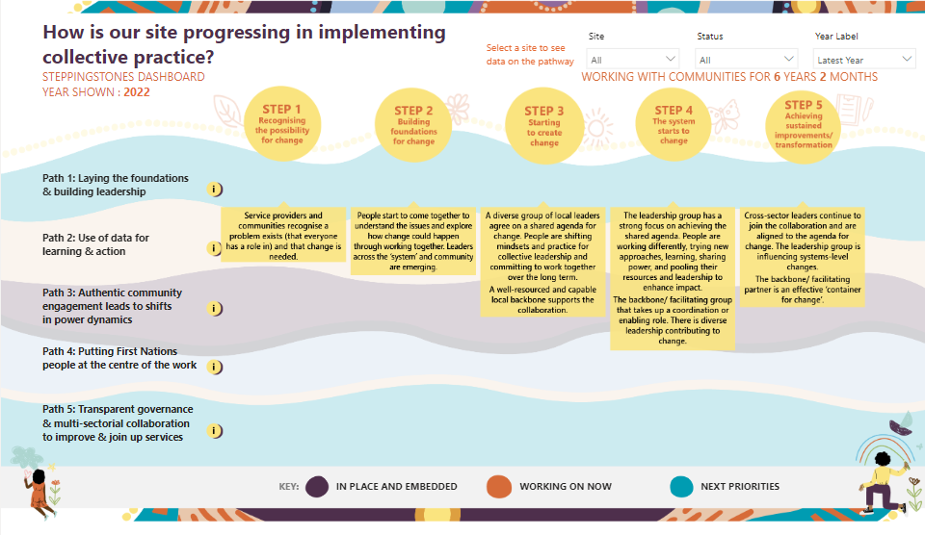
EXAMPLE: STEPPINGSTONES TOOL

Slide 25
QUESTIONS COMMENTS EXAMPLES ???

