Slide 1
INTRO TO UMEL FOR CONNECTED BEGINNINGS Ellise Barkley
Artwork used in the presentation is by Oumoula McKenzie

Slide 2
CONNECTED BEGINNINGS WORKING TOGETHER FOR STRONG COMMUNITIES, CHILDREN, AND FAMILIES

Slide 3
By working together…

Slide 4
By working together…
We link up services and community has positive experiences…

Slide 5
By working together…
We link up services and community has positive experiences…
Children are healthy, have a strong connection to culture, and are learning

Slide 6
Along the way, we listen to community, reflect, and gather and share information about what community want and the changes starting to happen.

Slide 7
Along the way, we listen to community, reflect, and gather and share information about what community want and the changes starting to happen.
This is….

Slide 12
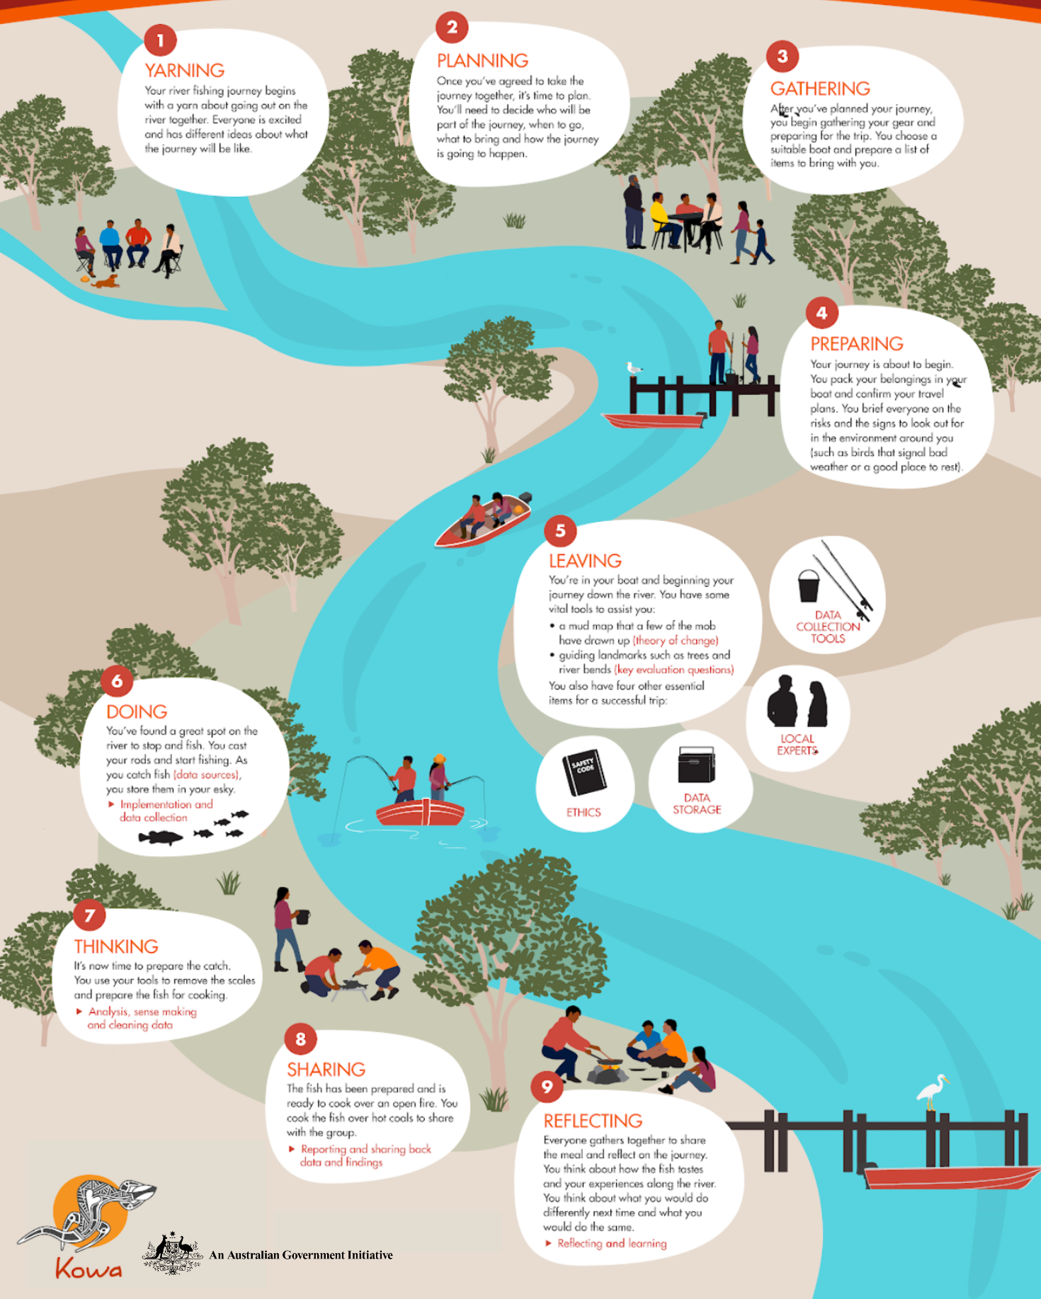
THE
LEARNING
JOURNEY
YARNING
PLANNING
GATHERING
PREPARING
LEAVING
DOING
THINKING
SHARING
REFLECTING

Slide 13
TOOLS
FOR THE JOURNEY
(!! JARGON ALERT !!)
THEORY OF CHANGE
MEASURES/ INDICATORS/ METRICS
KEY EVALUATION QUESTIONS
DASHBOARDS
DATA COLLECTION TOOLS AND METHODS
REFLECTION GATHERINGS
STEPPINGSTONES TOOL
INDIGENOUS DATA SOVEREIGNTY
ETHICS
DATA SHARING & STORAGE

Slide 14
UMEL HELPS:
PREPARE FOR AND MAP THE JOURNEY
COLLECT INFORMATION E.G. COMMUNITY VOICES, WHAT’S WORKING
SHARE WHAT’S HAPPENING WITH COMMUNITY AND PARTNERS
SHOW HOW AND WHERE YOU ARE MAKING AN IMPACT

Slide 15
GETTING STARTED:
DEDICATED PERSON OR GROUP
WORK ON IT TOGETHER
WORK OUT WHAT “GOOD” LOOKS LIKE FOR YOUR COMMUNITY
SUPPORT AND BUILD UP
EXPERIENCE IN UMEL
UNDERSTAND DATA SOVEREIGNTY
LEARN ABOUT WHAT WORKS AND WHAT DOESN’T WHEN COLLECTING, USING AND SHARING DATA & STORIES

Slide 16
AS PART OF THE WORK:
LISTEN, COLLECT STORIES AND FEEDBACK, USE & SHARE DATA
TRACK CHANGES
BRING PEOPLE TOGETHER TO REFLECT, LEARN AND PLAN (STEPPINGSTONE TOOL)
REPORT HOW IT’S GOING (EVERY 6 MONTHS)

Slide 17
RESOURCES:
UMEL COMMUNITY BOOKLET, GUIDE, & POSTERS
DATA DASHBOARDS
REFRESHED UMEL STRATEGY & GUIDE QUESTIONS
TOOLKIT –
STEPPINGSTONES TOOL
REPORTING TEMPLATES
IMPACT YARN GUIDE
TO FIND OUT MORE: ASK YOUR GOVERNMENT CONTACT

Slide 18
QUESTIONS COMMENTS EXAMPLES ???

